Slide 1
String
Chapter 5
Algorithms

Slide 2
Objectives
Concepts overview
String representation and String manipulation
String sorts
Key-indexed counting
LSD string sorts
MSD string sorts
String search
Tries
TrieST API

Slide 3
Concepts overview
Characters
A String is a sequence of characters
Characters are of type char and can have one of maximum 2¹⁶ possible values (may be 7-bit ASCII, 8-bit extended ASCII or 16-bit Unicode)
Immutability
String objects are immutable
It means they can be used in assignment statements, return values from methods and their values will not change
Indexing
Can be used to extract specified character from a string
charAt() method is Java’s String method used for this

Slide 4
Concepts overview
Length
Used to find the length of a string
It’s implemented in length() method in String class
Substring
Implements the extract a specified substring operation
It’s implemented in substring() method in String class
Concatenation
Creates new string formed by appending one string to another string
It’s built-in operation (+ operator)

Slide 5
Henry: examples
File name
File extension
Path before name
Arguments after command
Numbers from string
Replace all non-digit with space
Get fields

Slide 6
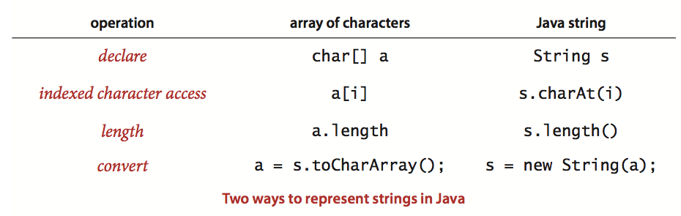
Concepts overview
Character arrays
Java String class is not primitive type, but it’s a class with operations to support client use
Many algorithms can work with String as low-level representation (array of char values)

Slide 7
tries
(string searching)

Slide 8
General purpose search vs Trie
We can make use of String properties in order to develop search method which is more efficient than general purpose methods, like:
Search hits take time proportional to the length of the search key
Search misses involve examining only a few characters
We can use symbol-table API with also character-based operation as Data Structure for String search

Slide 9
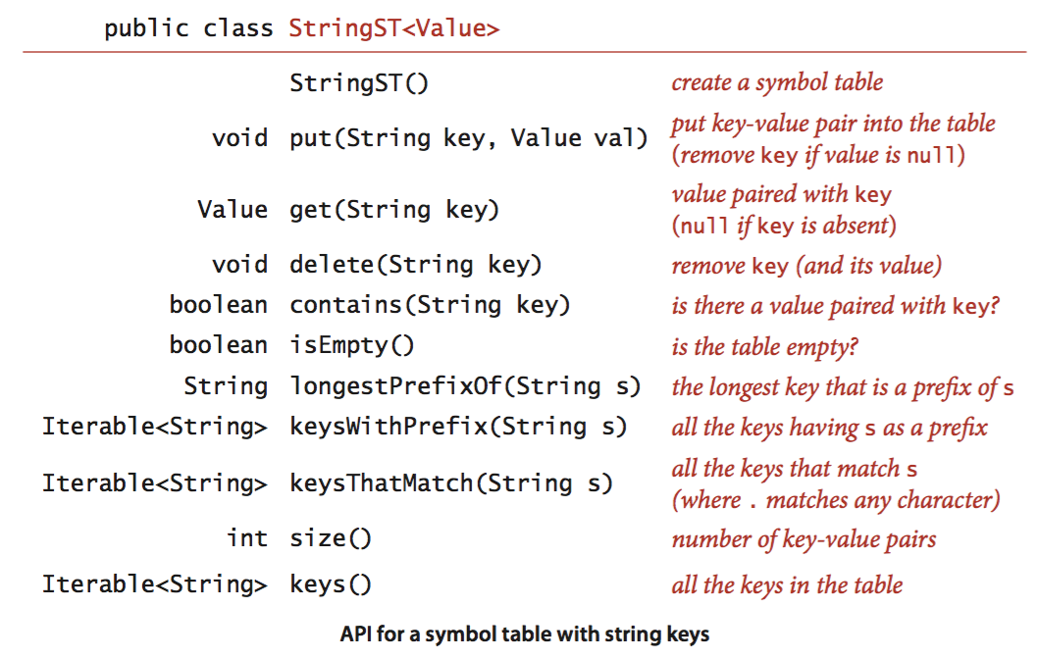
Symbol-table API

Slide 10
Three special methods for String
Following demonstration use this example: “she sells sea shells by the sea shore”
longestPrefixOf()
Input a string and returns longest key that is a prefix of that string
E.g., longestPrefixOf(“shell”) is “she”
keysWithPrefix()
Input a string and returns all the keys having that string as prefix
E.g., keysWithPrefix(“she”) return “she”, “shells”
keysThatMatch()
Input a string and returns all the keys that match that string. (.) operator match any character
E.g., keysThatMatch(“.he”) returns “she”, “the”

Slide 11
Basic properties of Trie
Similar to search tree, tries are data structures composed of nodes that contain links that are either null or references to other nodes
Each node is pointed to by just one other node, which is called its parent (except for root)
Each node has R links (R is the alphabet size), some of which could be null
Each link corresponds to a character value – since each link points to exactly one node, we label each node with the character value corresponding to the link that points to it (except for the root, which has no link pointing to it)
Each node has corresponding value, which may be null or the value associated with one of the string keys in the symbol table
Specifically, we store the value associated with each key in the node corresponding to its last character

Slide 12
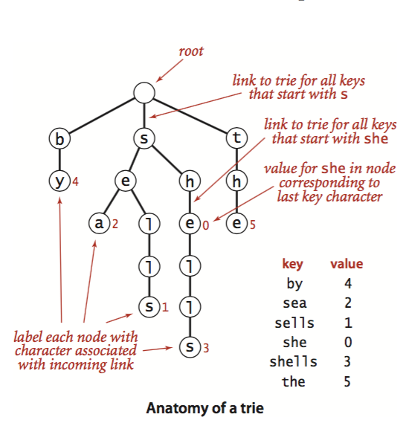
Trie example

Slide 13
Search in a trie
Each node in the trie has a link corresponding to each possible string character
We start at the root, then follow the link associated with the first character in the key
From that node we follow the link associated with the second character, so on and so forth
Until reaching the last character of the key or a null link. At this point, one of the following three conditions holds
The value at the node corresponds to the last character in the key is not null. This results is search hit – the value associated with the key is the value in the node
The value in the node corresponding to the last character in the key is null. This results to a miss.
The search terminated with a null link. This is also a miss.

Slide 14
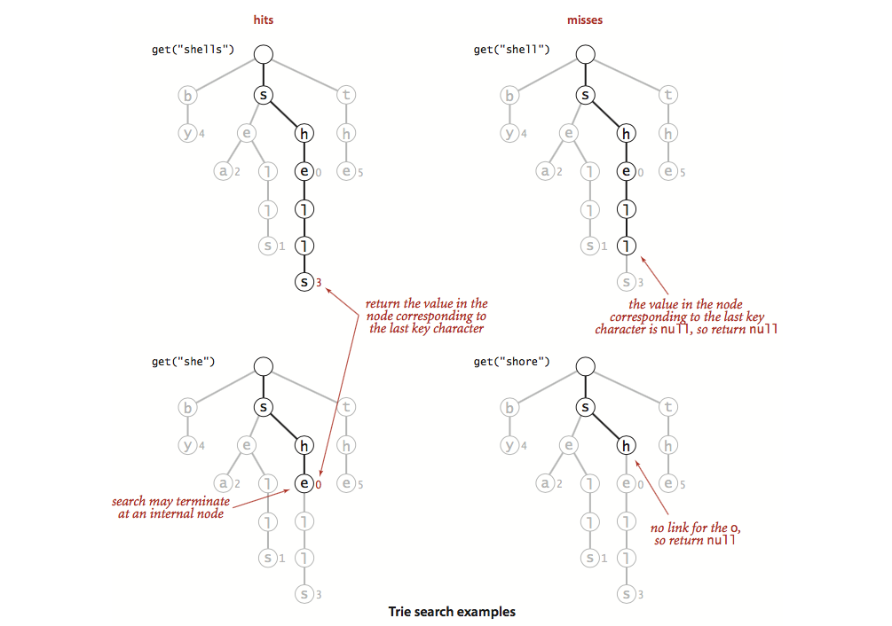
Search in a trie examples

Slide 15
Prefix listing
Search for emails with anh*
Find the node anh
Dump the node and list the items

Slide 16
Insertion into the trie
We insert by first doing a search using the characters of the key to guide us down the trie until reaching the last character of the key or a null link
At this point, one of the following two conditions hold
We encountered a null link before reaching the last character of the key then
Create node for each of the characters in the key not yet encountered
Set the value in the last one to the value to be associated with the key
We encountered the last character of the key before reaching a null link then
Set that node’s value to the value to be associated with the key (whether or not that value is null), as usual with our associative array convention

Slide 17
Node representation
Our trie diagrams do not quite correspond to the data structures our programs will build, because we do not draw null links
Taking null links into account emphasizes the following important characteristics of tries
Every node has R links, one for each possible character
Characters and keys are implicitly stored in the data structure

Slide 18
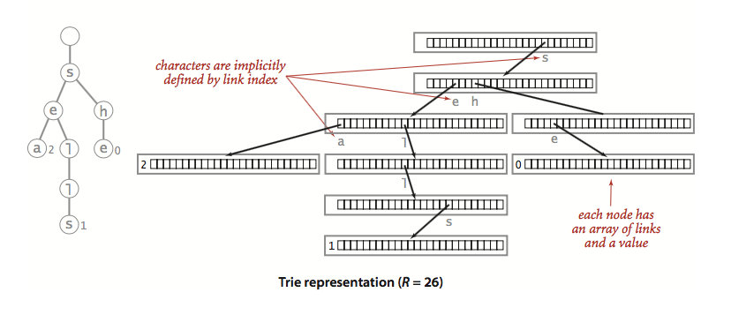
Node representation
Multi-layer hashing table representation
H2 = H1[x1]
H3 = h2[x2]

Slide 19
Henry: some implementation
Multi-layer hashing table
Very space consuming (sparse array)
Automation / map: character on edge/link
Each node nk contains the entry nk---char--nj where nj is the next node
Folder container: character on node/vertex
Each node contains one character
The root node does not have one

Slide 20
Trie data structure
Keys in the trie are implicitly represented by paths from the root that end at nodes with non-null values
E.g., string “sea” is associated with the value 2 in the trie because the 19th link in the root (which points to the trie for all keys that start with s) is not null and the 5th link in the node that link refers to (which points to the trie for all keys that start with “se”) is not null and the first link in the node that link refers to (which points to the trie for all keys that starts with “sea”) has the value 2
Neither the string “sea” nor the character s, e and a are stored in the data structure.
Indeed, the data structure contains no characters or strings, just links and values.
Since the parameter R plays such a critical role, we refer to a trie for an R-character alphabet as an R-way trie

Slide 21
Size
As for binary search tree, three straightforward options are available for implementing size()
An eager implementation where we maintain the number of keys in an instance variable N
A very eager implementation where we maintain the number of keys in a subtrie as a node instance variable that we update after the recursive calls in put() and delete()
A lazy recursive implementation. It traverses all of the nodes in the trie, counting the number having a non-null value

Slide 22
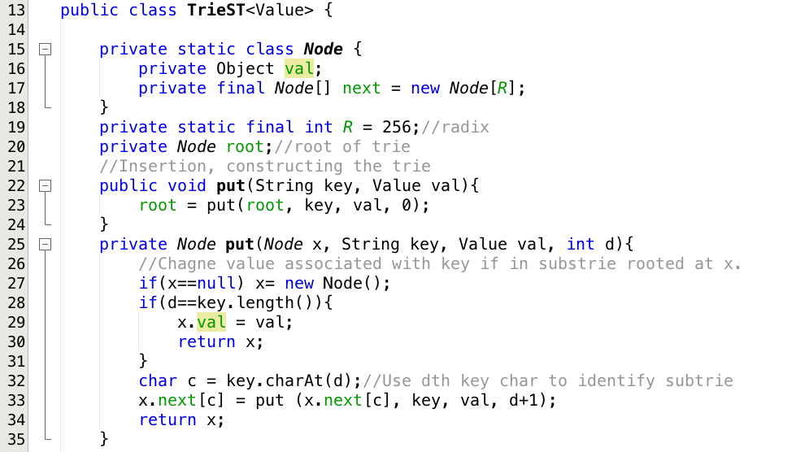
put() method

Slide 23
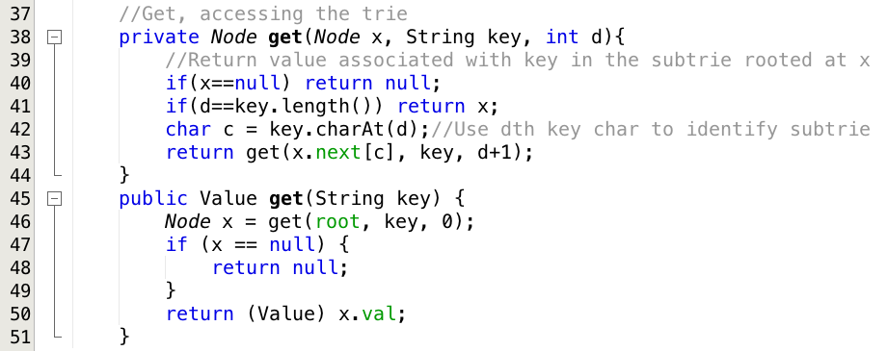
get() method

Slide 24
Collecting keys
Because characters and keys are represented implicitly in tries, we need to provide clients with the ability to iterate through the keys
We need to create explicit representations for all the string keys, not just find them
We do so with a recursive private method collect() that is similar to size() but also maintains a string with the sequence of characters on the path from the root
Each time that we visit a node via a call to collect() with that node as first argument, the second argument is the string associated with that node
To visit a node, we add its associated string to the queue if its value is not null, then visit (recursively) all the nodes in its array of links, one for each possible character
To create the key for each call, we append the character corresponding to the link to the current key
We use this collect() method to collect keys for both the keys() and the keysWithPrefix() methods in the API
To implement the keys() we call keysWithPrefix() with the empty string as argument
To implement keysWithPrefix(), we call get() to find the trie node corresponding to the given prefix (null if there is no such node), then use the collect() method to complete the job.

Slide 25
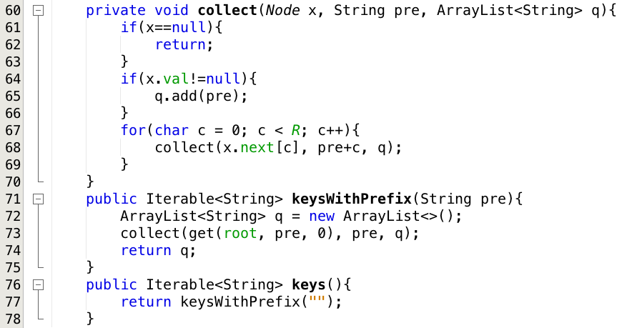
Collecting keys

Slide 26
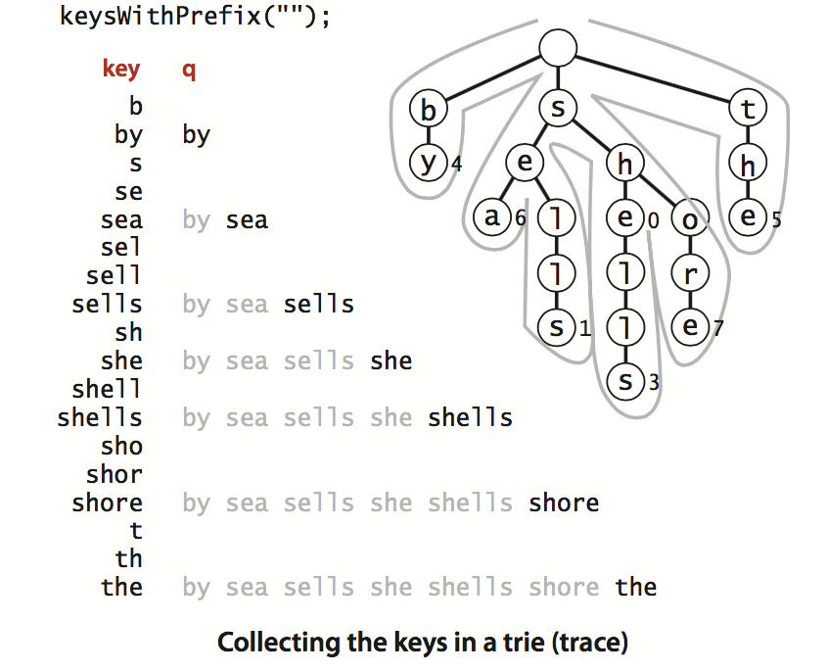
Collecting the keys in a trie (trace)

Slide 27
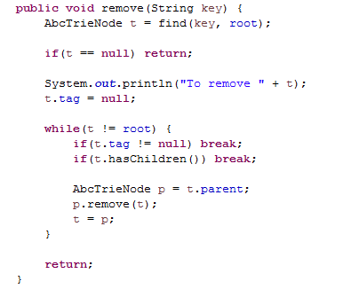
Deletion
The first step needed is to use a normal search to find the node and set the corresponding value to null
If that node has non-null link to a child, then no more work is required
If all the links are null, we need to remove the node from the data structure.
If doing so leaves all the links null in its parent, we need to remove that node, and so forth
We use recursive setup: after the recursive calls for a node x, we return null if the client value and all of the links in a node are null; otherwise we return x

Slide 28
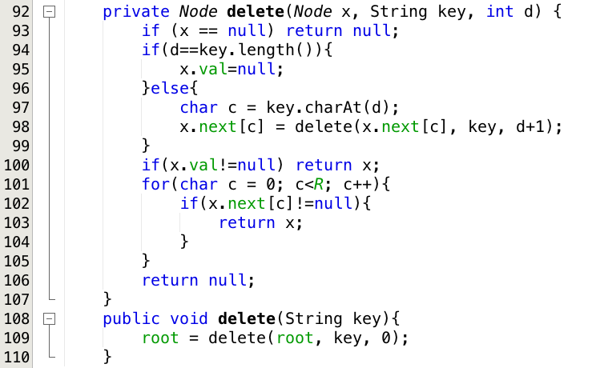
Delete

Slide 29
String list sorting
LSD, MSD, key-index

Slide 30
String sorts – two main approaches
First, examine characters in the keys in right-to-left order
Least-significant-digit (LSD) string sorts
Thinking of a string as a base-256 number, considering characters from right to left, the least significant digits first
This method is used when all keys are of the same length
Second, examines the characters in the keys in a left-to-right order
Most-significant-digit first (MSD)
We can get the sorts done without having to check all of the input characters

Slide 31
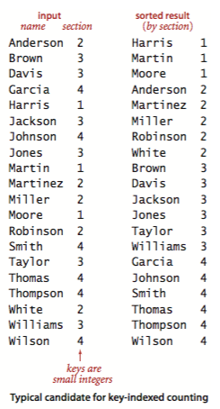
Key-indexed counting
Simple method for sorting, effective whenever the keys are small integers
It is basis for two of the string sorts that we will study
Scenario
Maintaining grades for a class with students assigned to sections (1, 2, 3, …)
List class by section
Assume data is kept in array a[] of items
Each item contains name, section number
Code a[i].key() returns the section number

Slide 32
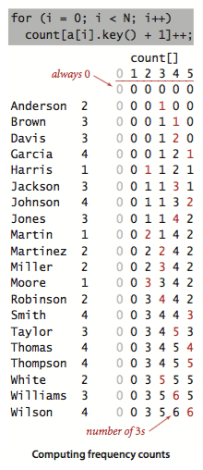
Key-indexed counting steps
1. Compute frequency counts
Count frequency each key value using an int array count[]
For reach item, we use the key to access an entry in count[] and increment that entry
If the key value is r, we increment count[r+1] (why +1 is explained in the next step)

Slide 33
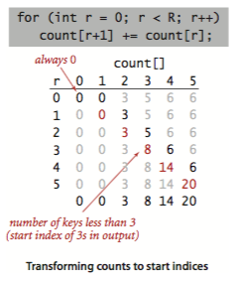
Key-indexed counting steps
2. Transform counts to indices
For each key value, compute the starting index positions in the sorted order of items with that key
E.g., three items with key 1 and five items with key 2, then the items with key 3 start at position 8 in the sorted array
To get starting index for items with any given key value we sum the frequency counts of smaller values (including itself) . This is the reason in step 1 we increment count[r+1] for each value r found
For each key value r, the sum of the counts for key values less than r+1 is the start index of items with key r
Keeping the [A, B] inteverals for each index

Slide 34
Henry: we can have the start/stop
C[j] = the count of key j
S[j] = the starting point of key j
We can compute S[j] = (j==0 ? 0 : S[j-1] + C[j])
We use C[j] and S[j] to transform
We wants to say that: the key j having C[j] items and occupying the space from S[j] to S[j]+C[j] inside the array

Slide 35
Key-indexed counting steps
3. Distribute the data
Move the items to an auxiliary array aux[]
We move each item to the position in aux[] indicated by the count[] entry corresponding to its key from step 2
Then increment that entry to maintain the following invariant for count[]: for each key value r, count[r] is the index of the position in aux[] where the next item with key value r (if any) should be placed
This process produces a sorted result with one pass through the data
Note: in one of our applications, the fact that this implementation is stable is critical: items with equal keys are brought together but kept in the same relative order (before the sorting)

Slide 36
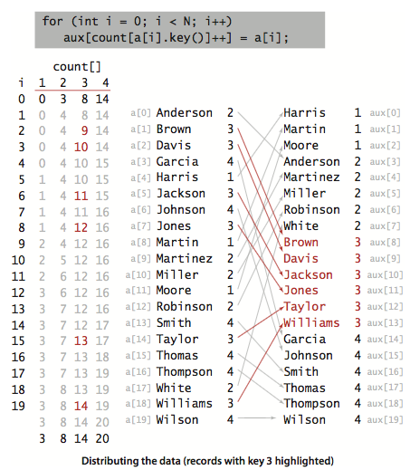
Distribution phase

Slide 37
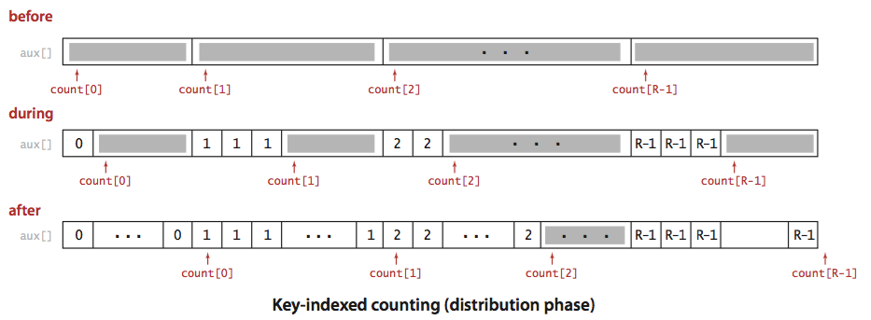
Distribution phase

Slide 38
Key-indexed counting steps
4. Copyback
Since we accomplished the sort by moving the items to an auxiliary array, the last step is to copy the sorted result back to the original array

Slide 39
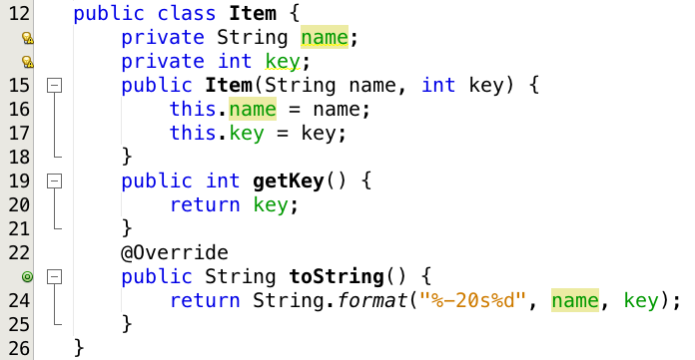
Key-indexed counting Demo

Slide 40
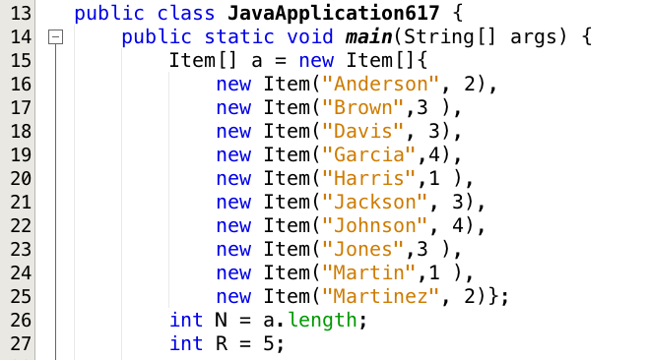
Key-indexed counting Demo

Slide 41
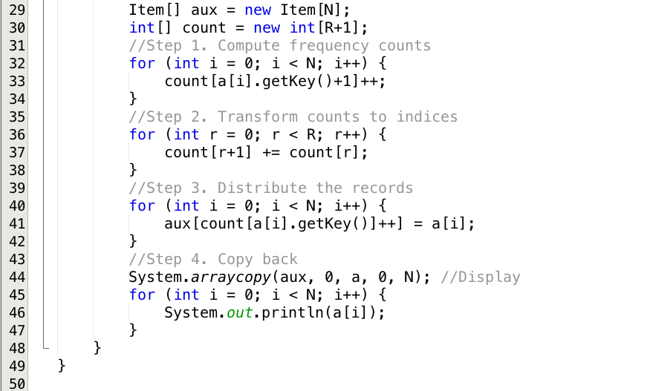
Key-indexed counting Demo

Slide 42
LSD sorting

Slide 43
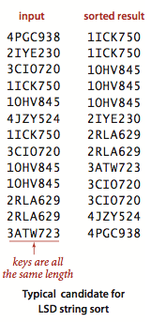
LSD String Sorts
Scenario:
Highway engineer sets up a device that records the license plate numbers of all vehicles for given period of time and to know the number of different vehicles that used the highway
One way is to sort the numbers then count the different values
License plates are mixture of letters and numbers so it’s reasonable to represent them as strings
Just to make it simple all license plates have the same number of characters (other cases as well like IP, bank-account numbers, etc)

Slide 44
LSD String Sorts
Sorting such strings can be done with key-indexed counting
If the strings are each of length W, we sort the strings W times with key-indexed counting
Use each of the positions as the key and the character value as the value of the key
Proceed from right to left
This works since the key-indexed counting implementation is stable

Slide 45
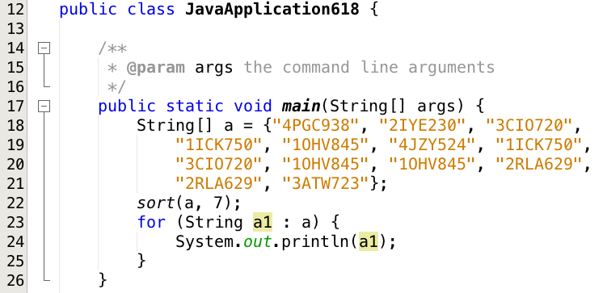
LSD String Sort Demo

Slide 46
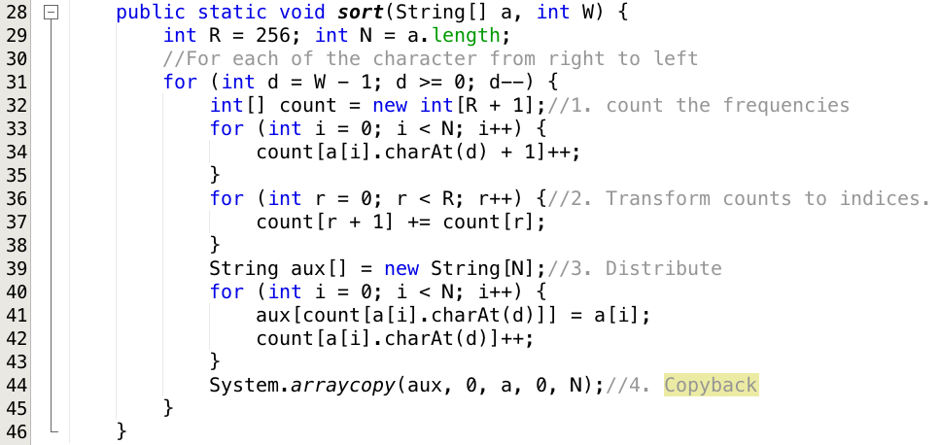
LSD String Sort Demo

Slide 47
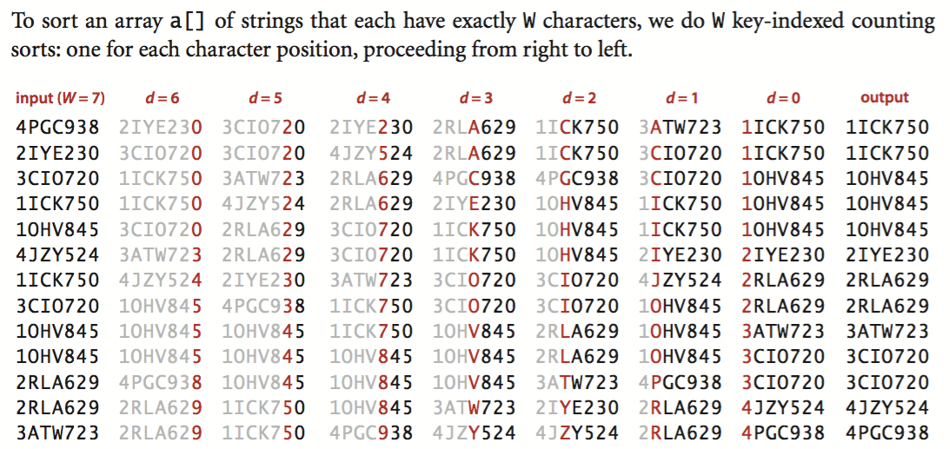
Trace of the program

Slide 48
MSD sorting

Slide 49
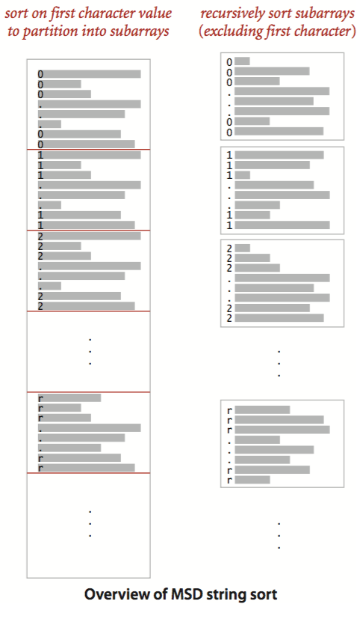
MSD String Sort
It’s recursive method known as most-significant-digit-first (MSD)
Use key-indexed counting to sort the strings based on their first character
Then (recursively) sort the subarrays corresponding to each character
Like quicksort, this partitions array into subarrays that can be sorted independently to complete the job
But it partitions based on each possible value of the first character
Instead of the two or three partitions in quicksort

Slide 50
End-of-string convention
For a proper sort, we need the subarray for strings whose characters have all been examined to appear as the first subarray, and we do not want to recursively sort this subarray
To facilitate this we need a method that returns – 1 if the specified position is past the end of the string
Then we will just add 1 to each return value, to get a nonnegative int that we can use to index count[]
This convention means that we have R+1 different possible character values at each string position: 0 to signify end of string, 1 for the first alphabet character, 2 for the second alphabet character, and so forth.
Since key-indexed counting already needs one extra position, we use the code int count[] = new int[R+2]; to create the array of frequency counts

Slide 51
Small subarrays
We add a test to cutoff to insertion sort for small
Normally, strings are sorted after examining only a few characters in the key, means the method quickly divides the array to be sorted into small subarrays
So we need to handle huge numbers of tiny subarrays, therefore, we need to handle them efficiently
E.g., suppose that you are sorting millions of ASCII strings (R=256) that are all different, with no cutoff for small subarrays
Each string eventually finds its way to its own subarray
So you will sort millions of subarrays of size 1
Each sort involves initializing 258 entries of the count[]
This cost is likely to dominate the rest of the sort. With Unicode (R=65536) the sort might be thousands of times slower.
So switching to insertion sort for small subarrays is a must for MSD string sort

Slide 52
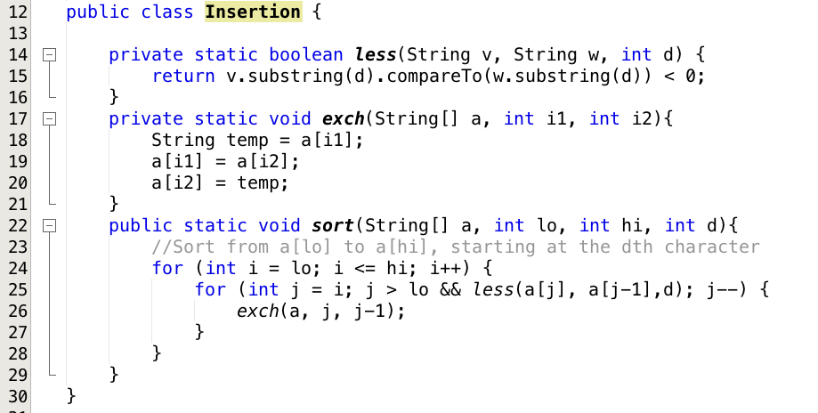
MSD String Sort Demo
To be used later on
To avoid the cost of reexamining characters that we know to be equal, we use the insertion sort, which takes an extra argument d and assumes that the first d characters of all the strings to be sorted are equal

Slide 53
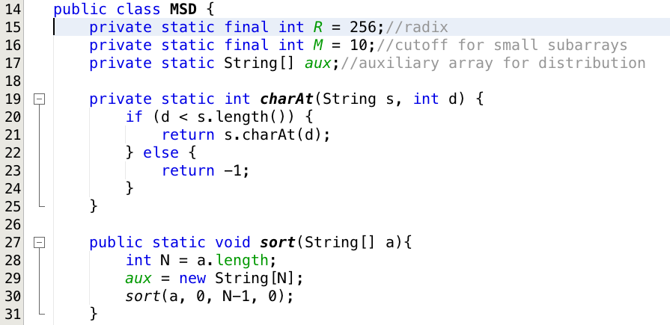
MSD String Sort Demo

Slide 54
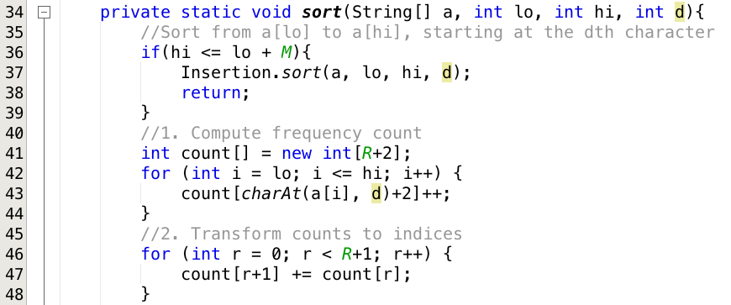
MSD String Sort Demo

Slide 55
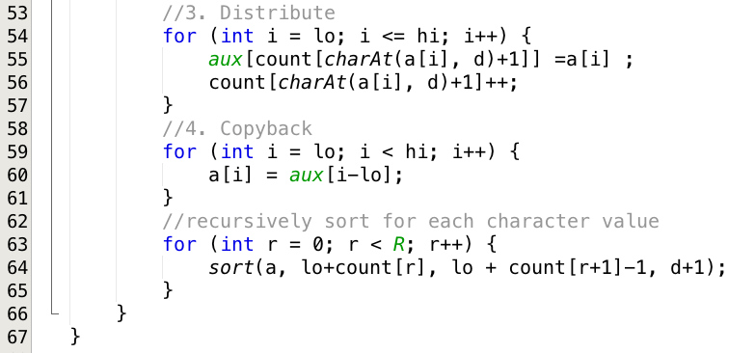
MSD String Sort Demo

Slide 56
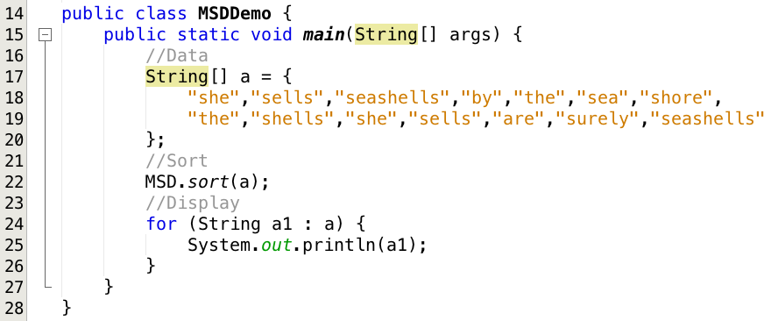
MSD String Sort Demo

Slide 57
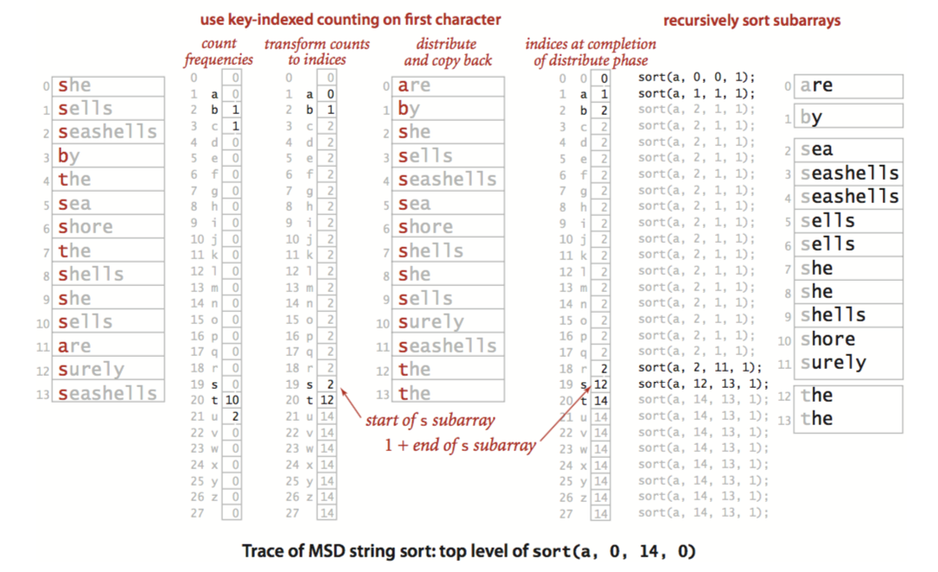
Trace of MSD string sort

Slide 58
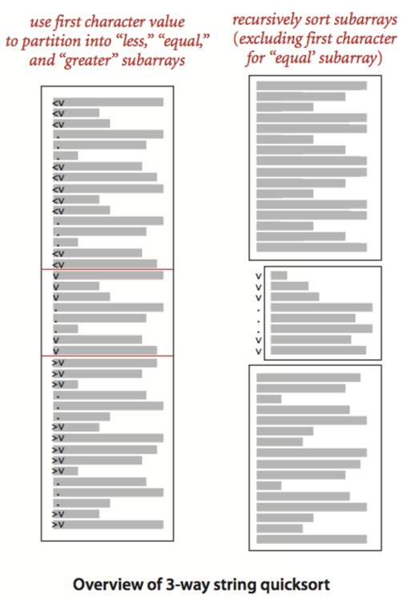
Three-way string quicksort*
We can also adapt quicksort to MSD string sorting by using 3-way partitioning on the leading character of the keys
Moving to the next character on only the middle subarray (keys with leading character equal to the partitioning character)
We just add an argument to the recursive method to keep track of the current character, and appropriately modify the recursive calls
*: This is optional for this course, please read the reference book for further details if you are interested

Slide 59
Henry: in-place and out-of-space
We want in-place sorting because
We don’t want to waste storage
We don't want alloc / dealloc to be called all the time
We cannot avoid out-of-space sorting if
We need many machines (map-reduce)
We need temporary storage (merge sort)
We need to simplify the code (reusing may cause more exchanging operations)
We don’t have enough memory to sort (large files do not fit the RAM)

Slide 60
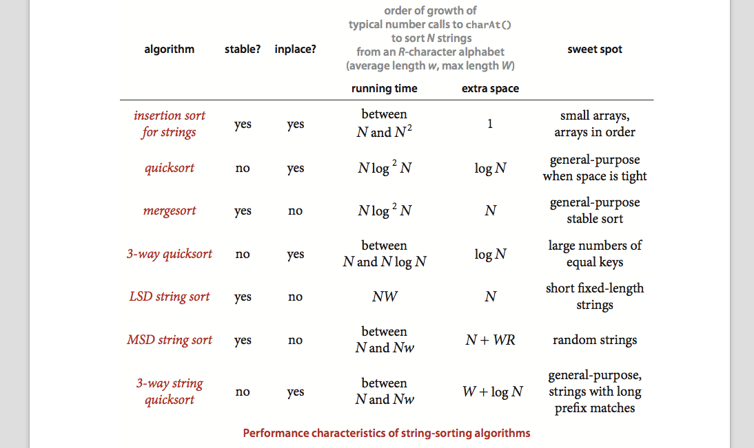
What algorithm should I use?

Slide 61
Summaries
Concepts overview
String representation and String manipulation
String sorts
Key-indexed counting
LSD string sorts
MSD string sorts
String search
Tries
TrieST API

